Slide 1
Qiskit Pulse
a Framework for Pulse-Level Control

Slide 2
Intro to Qiskit Pulse
Qiskit Circuit model – abstraction that hides the gates’ nature
Qiskit Pulse – provides pulse-level control of IBM quantum systems
Pulses are discrete time-series of amplitudes

Slide 3
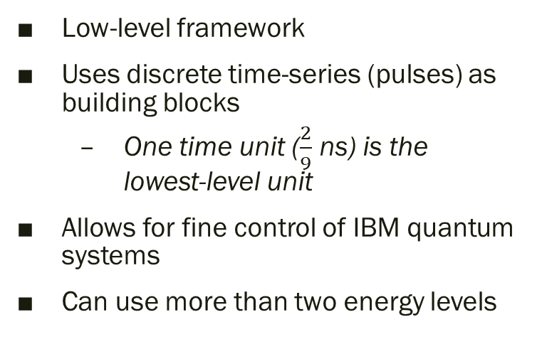
Comparison between Circuit and Pulse-Level Control
Qiskit Circuit model
Qiskit Pulse
High-level abstraction
Uses gates as building blocks
Gates are pre-calibrated
Saves time from calibration
Limits access to hardware
Uses first two energy levels only
Low-level framework
Uses discrete time-series (pulses) as building blocks
One time unit ($\frac{2}{9}$ ns) is the lowest-level unit
Allows for fine control of IBM quantum systems
Can use more than two energy levels

Slide 4
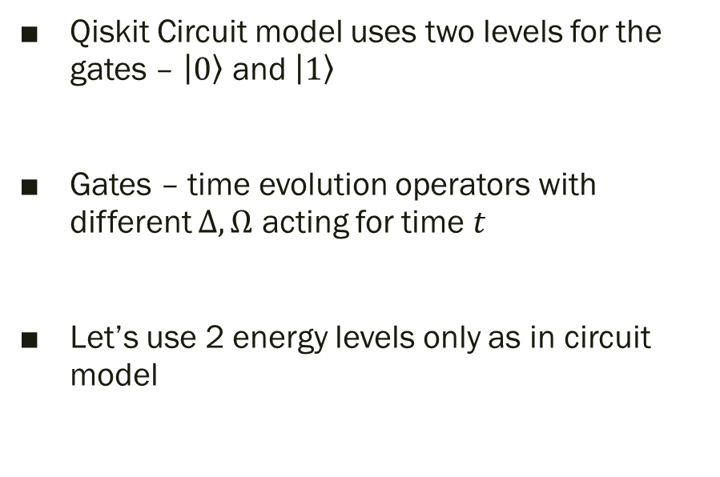
How to make the quantum gates?
Qiskit Circuit model uses two levels for the gates – $\left|0\right\rangle$ and $\left|1\right\rangle$
Gates – time evolution operators with different $Δ, Ω$ acting for time $t$
Let’s use 2 energy levels only as in circuit model

Slide 5
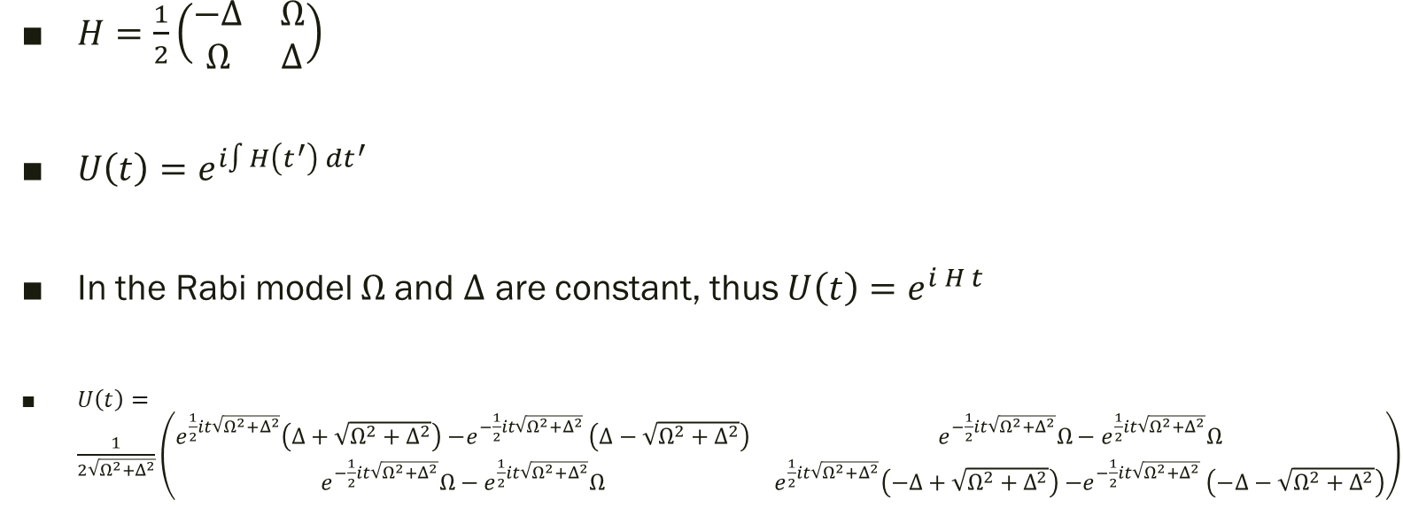
Time Evolution Operator
$H=\frac{1}{2}\left(\begin{matrix}−Δ & Ω \\ Ω & Δ\end{matrix}\right)$
$U\left(t\right)=e^{i∫H\left(t^{′}\right) dt^{′}}$
In the Rabi model $Ω$and $Δ$ are constant, thus $U\left(t\right)=e^{i H t}$
$U\left(t\right)=\frac{1}{2\sqrt{Ω^{2}+Δ^{2}}}\left(\begin{matrix}e^{\frac{1}{2}it\sqrt{Ω^{2}+Δ^{2}}}\left(Δ+\sqrt{Ω^{2}+Δ^{2}}\right){−e}^{−\frac{1}{2}it\sqrt{Ω^{2}+Δ^{2}}}\left(Δ−\sqrt{Ω^{2}+Δ^{2}}\right) & e^{−\frac{1}{2}it\sqrt{Ω^{2}+Δ^{2}}}Ω−e^{\frac{1}{2}it\sqrt{Ω^{2}+Δ^{2}}}Ω \\ e^{−\frac{1}{2}it\sqrt{Ω^{2}+Δ^{2}}}Ω−e^{\frac{1}{2}it\sqrt{Ω^{2}+Δ^{2}}}Ω & e^{\frac{1}{2}it\sqrt{Ω^{2}+Δ^{2}}}\left(−Δ+\sqrt{Ω^{2}+Δ^{2}}\right){−e}^{−\frac{1}{2}it\sqrt{Ω^{2}+Δ^{2}}}\left(−Δ−\sqrt{Ω^{2}+Δ^{2}}\right)\end{matrix}\right)$

Slide 6
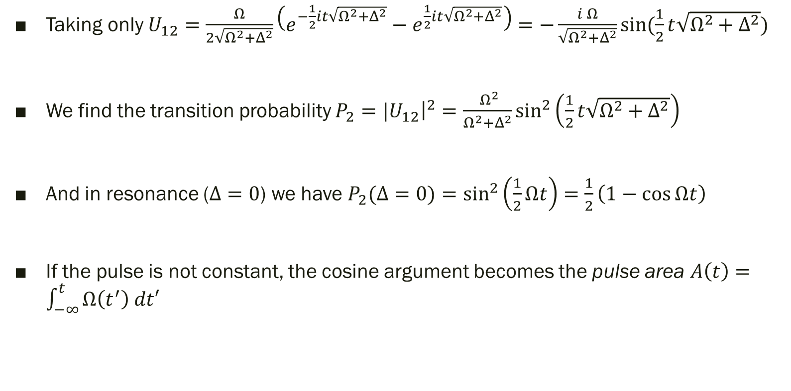
Time Evolution Operator
Taking only $U_{12}=$ $\frac{Ω}{2\sqrt{Ω^{2}+Δ^{2}}}\left(e^{−\frac{1}{2}it\sqrt{Ω^{2}+Δ^{2}}}−e^{\frac{1}{2}it\sqrt{Ω^{2}+Δ^{2}}}\right)=−\frac{i Ω}{\sqrt{Ω^{2}+Δ^{2}}}\sin{(\frac{1}{2}t\sqrt{Ω^{2}+Δ^{2}})}$
We find the transition probability $P_{2}={|U}_{12}{\left.​\right|}^{2}=$ $\frac{ Ω^{2}}{Ω^{2}+Δ^{2}}\sin^{2}\left(\frac{1}{2}t\sqrt{Ω^{2}+Δ^{2}}\right)$
And in resonance ($Δ=0$) we have $P_{2}(Δ=0)=\sin^{2}\left(\frac{1}{2}Ωt\right)=\frac{1}{2}\left(1−\cos{Ωt}\right)$
If the pulse is not constant, the cosine argument becomes the pulse area $A\left(t\right)=\int_{−∞}^{t}{Ω\left(t^{′}\right) dt′}$

Slide 7
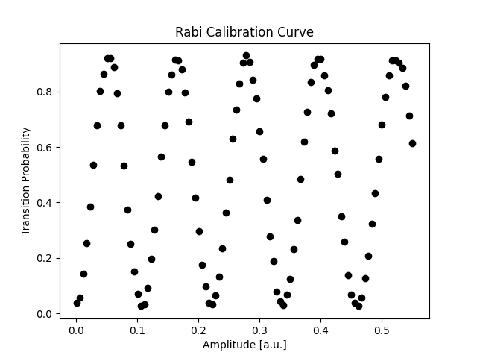
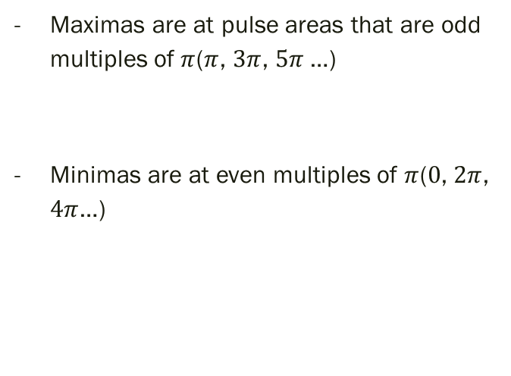
Demonstration of Rabi Oscillations
Maximas are at pulse areas that are odd multiples of $π$($π$, $3π$, $5π$…)
Minimas are at even multiples of $π$($0$, $2π$, $4π$…)

Slide 8
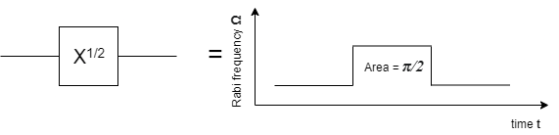
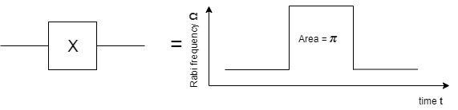
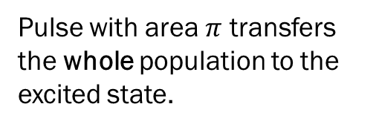
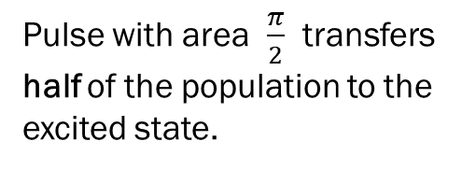
Common gates in Qiskit Pulse
Pulse with area $\frac{π}{2}$ transfers half of the population to the excited state.
Pulse with area $π$ transfers the whole population to the excited state.
But… how to make a Hadamard gate??

Slide 9

How to make a Hadamard?
Sqrt of X gate similarly transfers half of population to excited state
But ${\sqrt{X}}^{2}=X$, while $H^{2}=1$
In 2-level system only possible with non-zero detuning

Slide 10
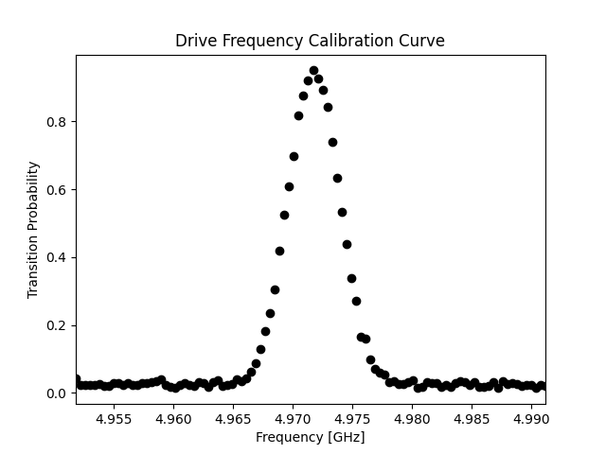
Choose Detuning for Hadamard
Do a frequency sweep around resonant frequency
Find the amplitude
Find the detuning for which the transition probability is half the maximum
This is the detuning that should be used for the Hadamard gate

Slide 11
Pulse Basics
Learn how to build and apply pulses

Slide 12
Qubit Calibration
Learn how to calibrate the qubit for further use

Slide 13
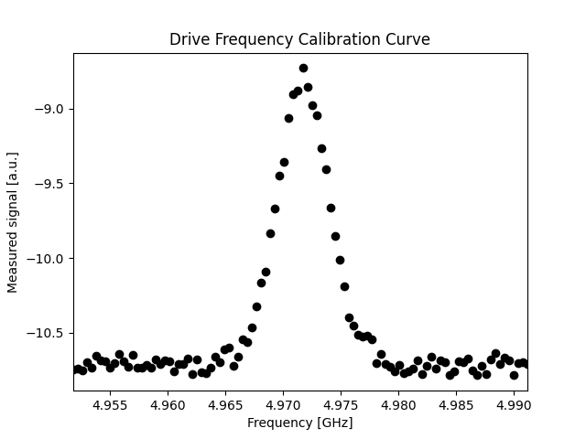
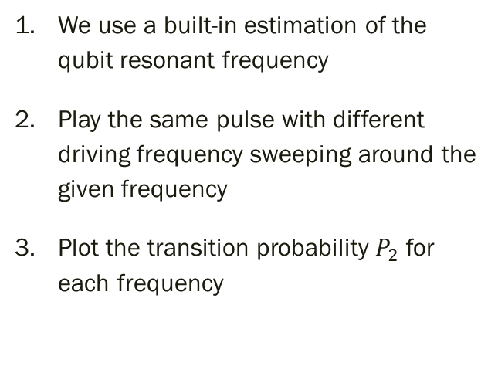
1st Step: Calibration of Resonant Frequency
We use a built-in estimation of the qubit resonant frequency
Play the same pulse with different driving frequency sweeping around the given frequency
Plot the transition probability $P_{2}$ for each frequency

Slide 14
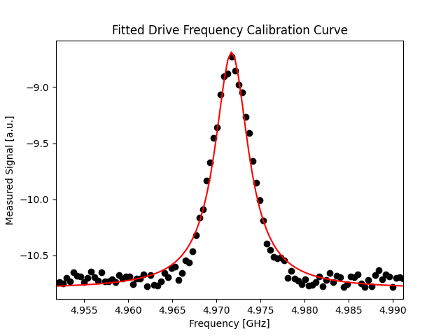
1st Step: Calibration of Resonant Frequency
4. Fit the resonance curve with a type of convex symmetric function (most often Lorentzian)
5. Take the parameters of the fit to find a value for the resonant frequency

Slide 15
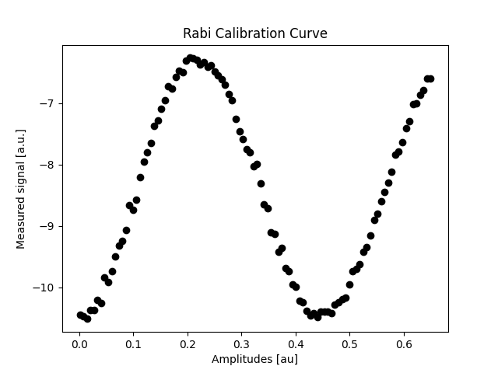
2nd Step: Calibration of Pulse Area
Using the previously found resonant frequency, conduct experiments with 1 pulse each
Apply a pulse of any shape while increasing the amplitude (Rabi frequency) with each test
Plot the transition probability (equiv. signal) for each amplitude

Slide 16
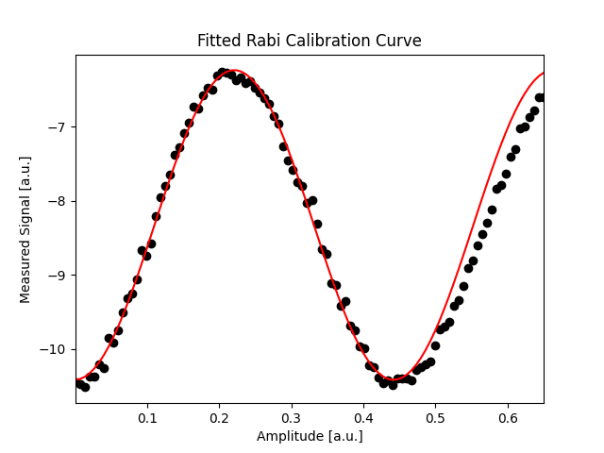
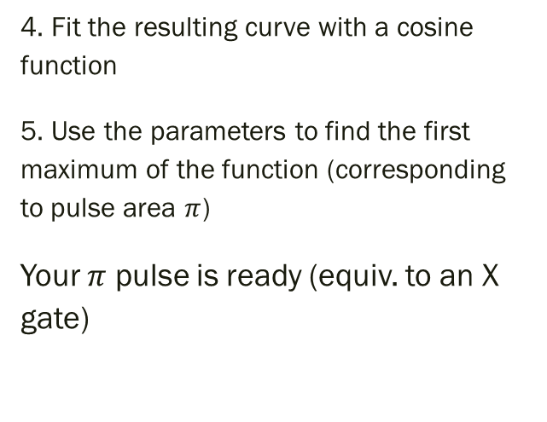
2nd Step: Calibration of Pulse Area
4. Fit the resulting curve with a cosine function
5. Use the parameters to find the first maximum of the function (corresponding to pulse area $π$)
Your $π$ pulse is ready (equiv. to an X gate)

Slide 17
3rd Step: Discriminator
Optional, because we can use a built-in Qiskit discriminator for 2 states only
The raw result from the experiment is a complex signal
One cannot differentiate the state of the particle directly
Classification of the measured signals is necessary

Slide 18
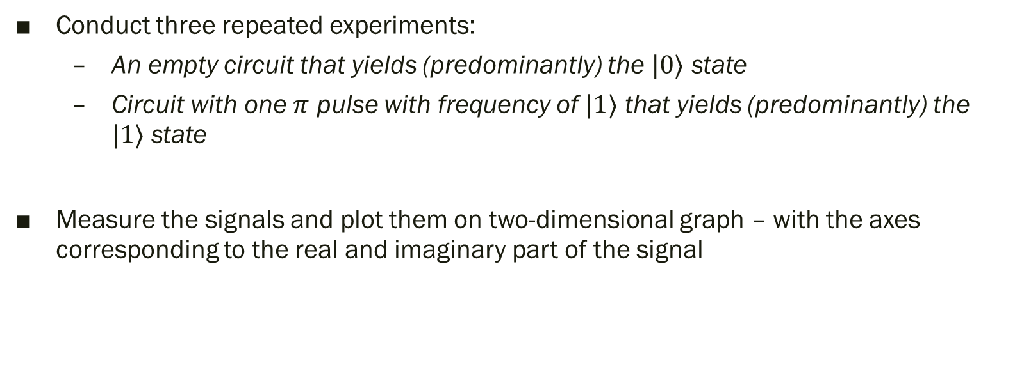
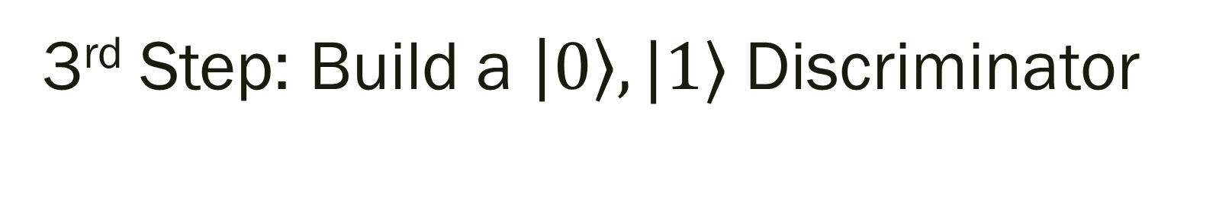
3rd Step: Build a $\left|0\right\rangle ,|1⟩$Discriminator
Conduct three repeated experiments:
An empty circuit that yields (predominantly) the $|0⟩$ state
Circuit with one $π$ pulse with frequency of $|1⟩$ that yields (predominantly) the $|1⟩$ state
Measure the signals and plot them on two-dimensional graph – with the axes corresponding to the real and imaginary part of the signal

Slide 19
Qiskit Pulse: Freedom to Customize Your Experiments in Numerous Ways
You can:
Access higher energy states
Apply pulses with custom waveforms (i.e. Gaussian, etc.)
Not change the detuning during the circuit execution, BUT…
Can apply complex Rabi frequencies which effectively create a detuning

Slide 20
the 3rd Energy Level
Learn how to access and use the 3rd energy state

Slide 21
Accessing the 3rd Energy Level
The procedure is analogous to the procedure for the first 2 states
There are 2 ways to excite population to the 3rd level:
Make a pulse with
Biggest difference – a discriminator is not available
Can be built by you

Slide 22
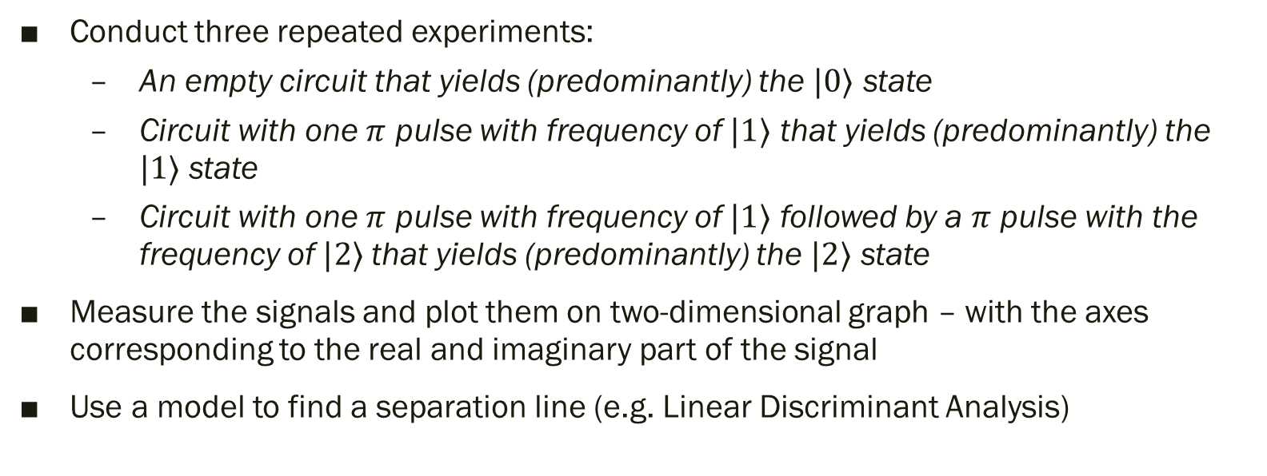
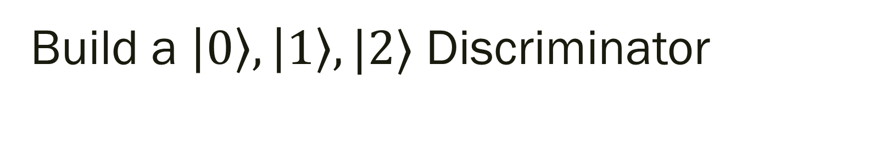
Build a $\left|0\right\rangle ,\left|1\right\rangle ,|2⟩$ Discriminator
Conduct three repeated experiments:
An empty circuit that yields (predominantly) the $|0⟩$ state
Circuit with one $π$ pulse with frequency of $|1⟩$ that yields (predominantly) the $|1⟩$ state
Circuit with one $π$ pulse with frequency of $|1⟩$ followed by a $π$ pulse with the frequency of $|2⟩$that yields (predominantly) the $|2⟩$ state
Measure the signals and plot them on two-dimensional graph – with the axes corresponding to the real and imaginary part of the signal
Use a model to find a separation line (e.g. Linear Discriminant Analysis)

Slide 23
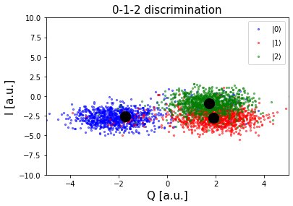
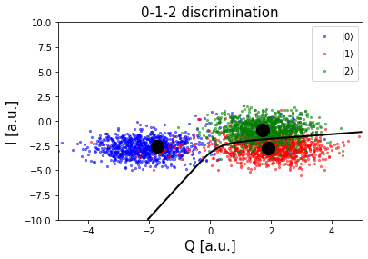
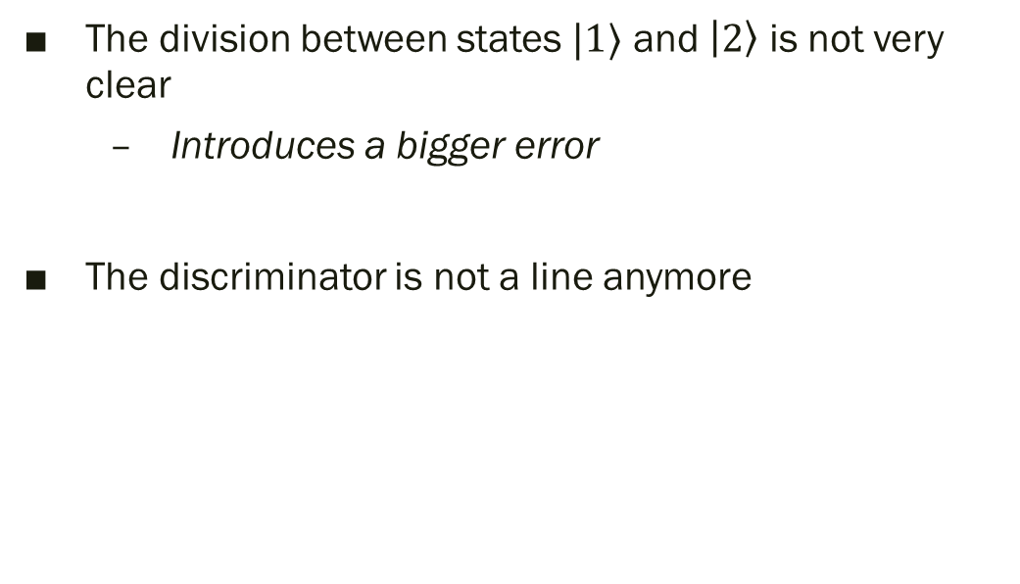

The $\left|0\right\rangle ,\left|1\right\rangle ,|2⟩$ Discriminator
The division between states $|1⟩$ and $\left|2\right\rangle$ is not very clear
Introduces a bigger error
The discriminator is not a line anymore

Slide 24
Any Questions?

